Slide 1
Key~
Bucket#: Salinity_pH_TA
West wall
East wall
#1: L_7.5_1000
#2:
A_7.5_2000
#3:
A_7.5_1000
#4:
L_8.0_3000
#5:
A_8.0_3000
#6:
A_8.0_2000
#10:
A_7.5_3000
#11:
L_8.0_2000
#7: Blank
L_8.0_1000
#8:
A_8.0_1000
#9:
L_7.5_3000
#12:
L_8.0_1000
#13:
L_7.5_2000
#14: Blank
A_8.0_1000

Slide 2
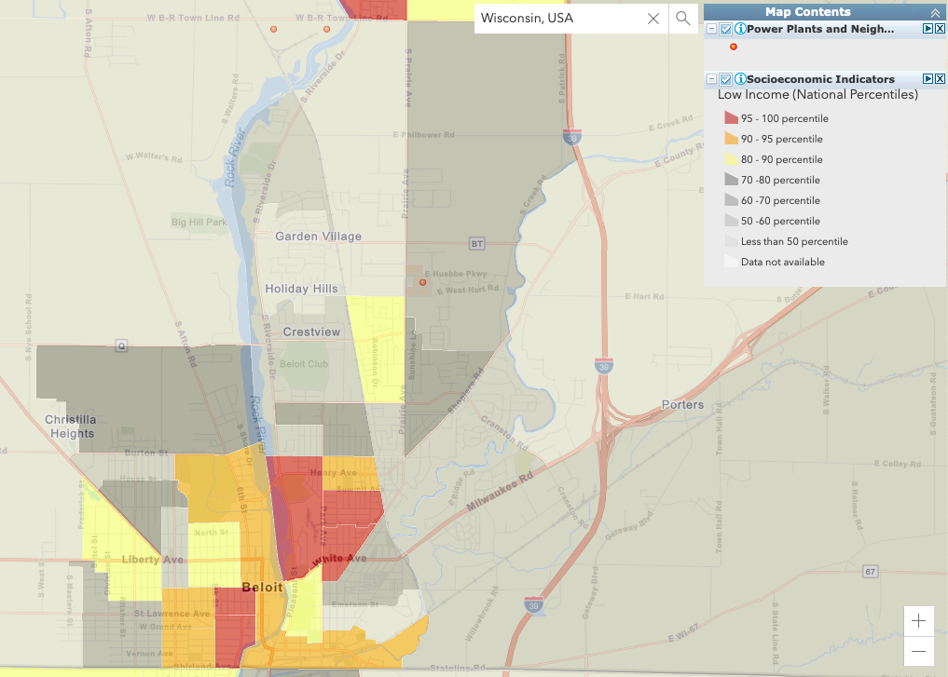
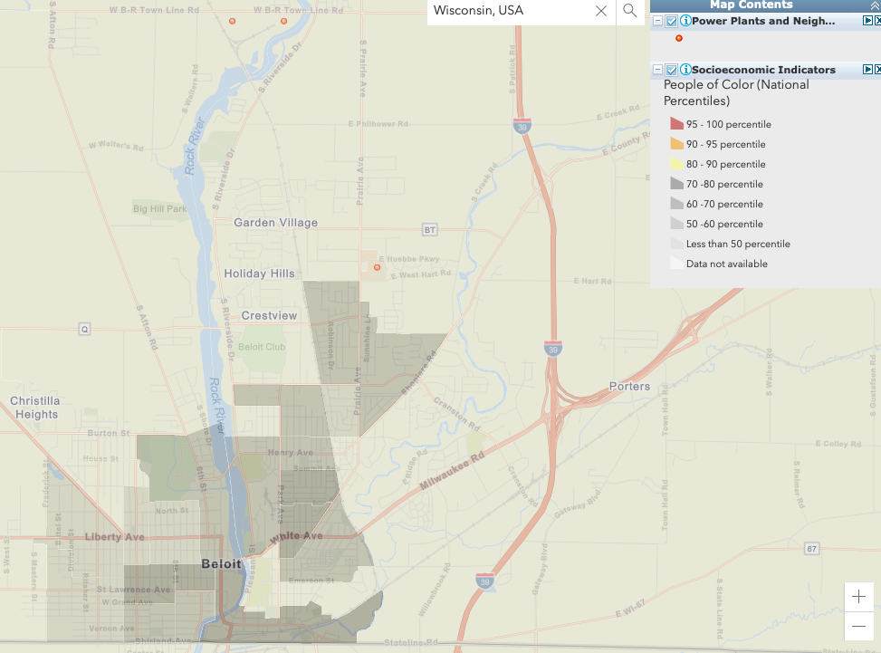
Figure 2. Screenshots taken from EJScreen online mapping tool. The selected areas displays surrounding communities and concurrent demographics near Alliant Energy’s West Riverside Energy Center, a recently converted and expanded natural-gas burning energy plant north of Beloit, WI. (A) Map is overlaid with indicator layer displaying the percentile of people of color that make up this area, relative to national percentiles, whereas (B) displays percentiles of the low-income indicator.
Alliant Energy’s West Riverside Energy Center
Alliant Energy’s West Riverside Energy Center
BELOIT, WI
BELOIT, WI
(A)
(B)

Slide 3
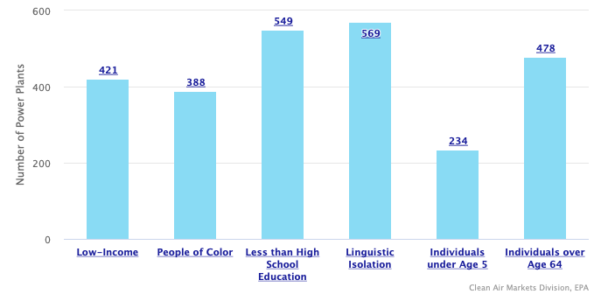
Figure 1. Screenshot taken from the EPA Clean Air Markets Division website displaying the number of powerplants (total plants =3477) in the United States of America that are located within communities at or above the 80th percentile nationally. Data are broken down further into the following socioeconomic indicators: low-income, people of color, less than high school education, linguistic isolation, individuals under age 5, individuals over age 64.

